Slide 1
Employee data analysis using excel
NAME : S.PRIYADHARSHINI
REGISTER NO . 312214934
DEPARTMENT : COMMERCE
COLLEGE : ANNAI veilankanni’s college
FOR. WOMEN

Slide 2
Project title
EMPLOYEE DATA ANALYSIS USING EXCEL

Slide 3
AGenda
PROBLEM STATEMENT
PROJECT OVERVIEW
END USER
OUR SOLUTION AND PROPOSITION
DATA SET DESCRIPTION
MODELLING APPROACH
RESULT AND DISCRIPTION
CONCLUSION

Slide 4
PROBLEM STATEMENT
EASE OF DATA
MANAGEMENT DATA
EASE OF USE VERSALITY

Slide 5
Who are the end users
BEGINNERS
ENTHUSIASTIS
ATHLETES
SENIOR
REHABILITATION

Slide 6
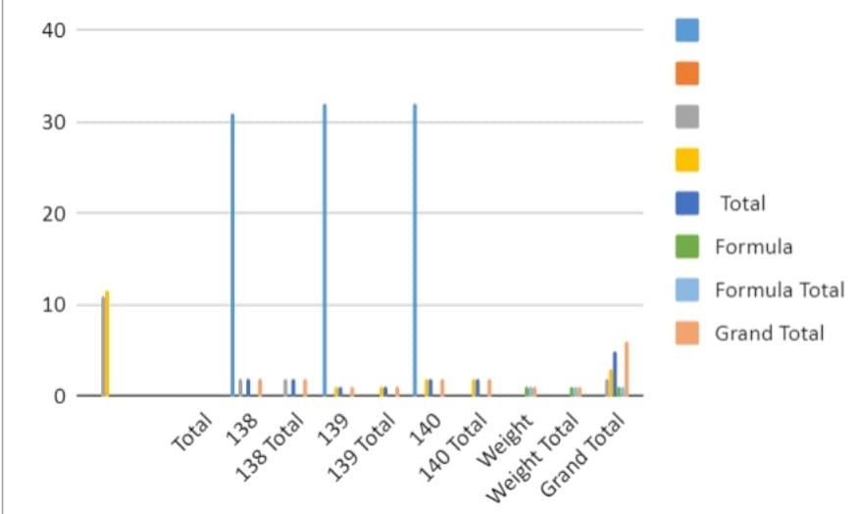
Results

Slide 7
Conclusion
ACHIEVING OPFIMAL FIFNESS IS WITHIN REACH! BY INCORPORATING PHYSICAL ACTIVITY, HEALTHY EATING, AND MINDFULNESS INTO OUR DAILY LIVES WE CAN IMPROVE OUR OVERALL WELL-BEING. LET’S LAKE THE FIRST STEP TOWARDS A HEALTHIER HAPPIER US – START YOUR FITNESS JOURNEY TODAY!

Slide 8
Thank you

